Slide 1
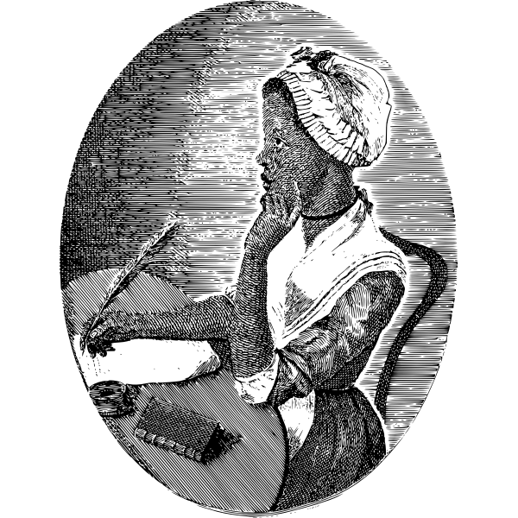
Dear Phillis,
References
https://www.newyorker.com/books/under-review/how-phillis-wheatley-was-recovered-through-history
https://collections.dartmouth.edu/occom/html/ctx/personography/pers0574.ocp.html
I know you and Nathaniel are in England. In fact, I am pleased to learn about your growing relationship with the Countess of Huntingdon. I am pleased she will help you with your book of poems. I'm so happy for you Phillis.
I hate to be the bearer of bad news, but I must share recent updates on my illness. Doctors are hopeful, but I have my good and bad days. I ‘m praying to get better. I don't want you or Nathaniel to worry but I want you to know that I’m sick. I’m really glad that your poems are being published, I’m so proud of you.
I remember bringing you into my home because you looked modest, humble, and you had interesting features. If my conditions worsens I will try to send another letter.
Love,
Susanna Wheatley

Slide 2
The Composition Process:
Read and discuss PWP together. Some questions can include: What made her unique? How was she different from other enslaved girls? Why is she an important historical figure? What would you tell your friends about her?
Think about another central figure or supporter for crafting the letter. Are there other key characters that stand out to students? George Washington was another person we discussed!
Research the figure. What was said about this person? How did this person align with PWP? Youtube videos were helpful in our case, and we had to look for age appropriate websites.
Compose the letter. Offering sentence stems were helpful to imagine what the central actor might have said to PWP. For ex: what might Susanna have been happy about? What might Susanna have felt nervous about? “I don’t want you and Nathaniel to worry, but…” Also consider how did Susanna feel about Phillis? How do we know that she felt this way? Pushing young writers to consider context can help them include additional important details. Length will vary depending on the student, and encouraging all of their ideas is helpful!
Design the slide. The design of the slide can be easy for students who like visuals and using their creativity. This part of the process required very minimal direction from me and was the perfect ending to a rigorous writing exercise!

