Slide 1
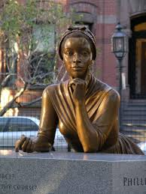
DFW Teachers on the Legacy of Phillis Wheatley for Their Classrooms
DFW Writes Phillis Wheatley Peters on the 250th Anniversary of her Poetry!
Texas Christian University | May 31, 2023
(slides created by DFW teachers at the 2023 Summer Literacy Institute hosted by TCU College of Education)
1

Slide 2
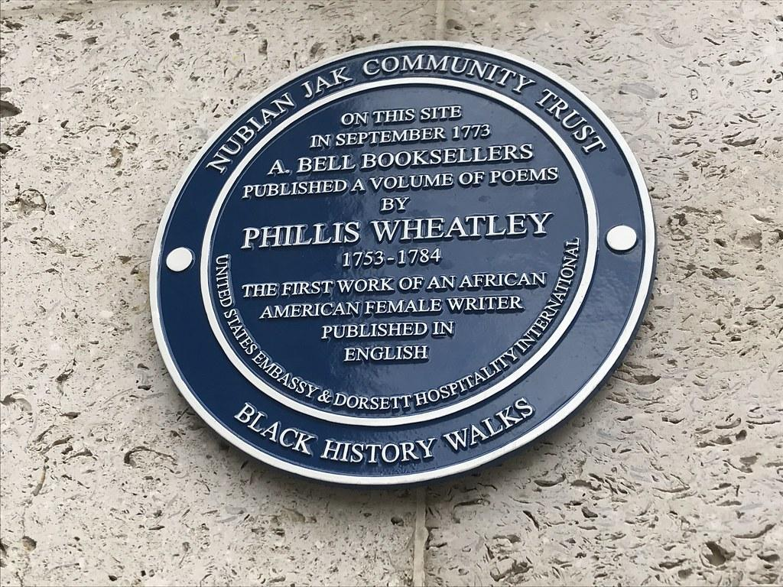
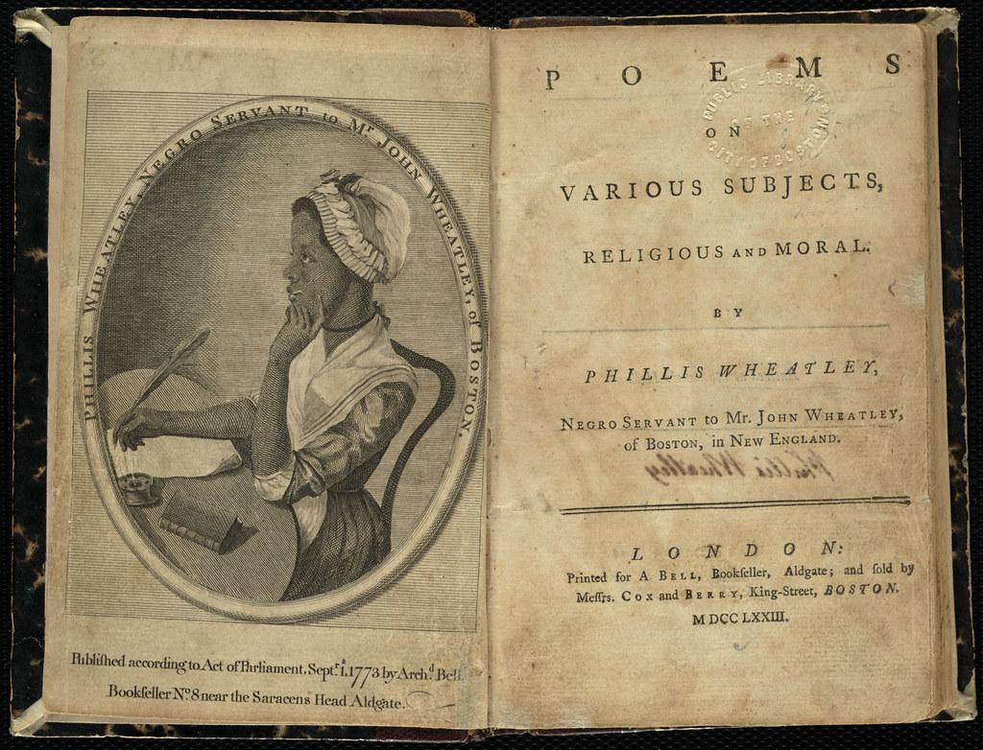
Thank-you for Your Poems
Thank you, Phillis.
For being a window into a past time
For writing to us by writing about others
For bringing your life to us.
For honoring Africa and Black Americans
Even in a time of slavery.
You give us hope.
You show us the power of words and writing.
Thank you.
Images:
Plaque at site of PWP’s original book publisher
Frontispiece and title page of her 1773 book
page created by Sarah Robbins
2

Slide 3
Words that Fly
If you don’t want someone to build, hide the wood and steel
Tell them where to go, what to do, how to feel
What can we learn from the girl named after a boat?
What doesn’t sink the ship can sometimes keep it afloat
If your mind is free then you can never be restrained
They can keep your body in a cage but a mind can’t be chained
Phillis used words to set herself free
Ink on a page as free as a fish in the sea
Words that can swim but also have wings to fly
Across the years and through the transcendent sky
Her words free us now, calling us home
The mind that is free will never be alone
Never be alone
You are not alone
We are not alone
3
page created by Curby Alexander

Slide 4
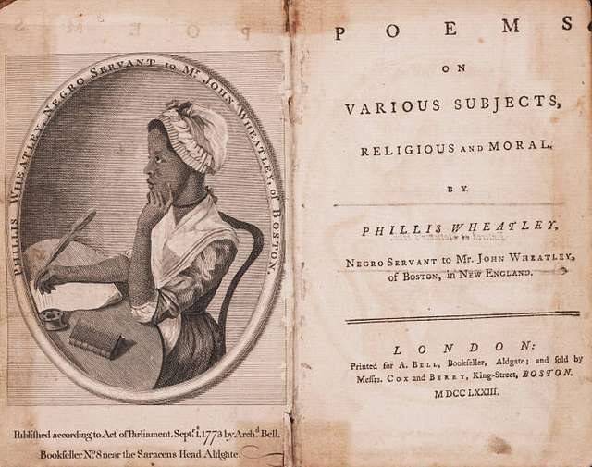
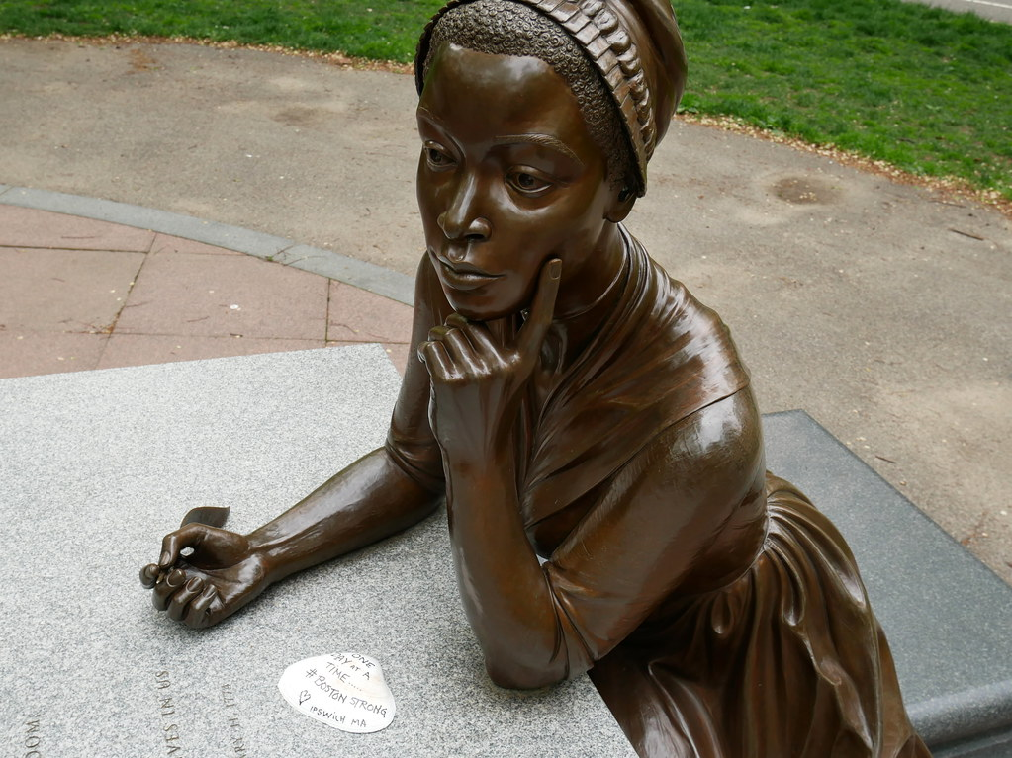
A Writer and Role Model
Phillis Wheatley was a young writer.
She is the young girl that was renamed upon her arrival to America.
She is the young slave of the Wheatley family in Boston.
She is a learner, observing and practicing the formation of letters.
She is a creator as she uses her writing skills to craft poems.
She is the poet who had to sail to Europe in order to have her poems published, just because of the color of her skin.
Phillis Wheatley is a role model to all.
She is self-taught.
She is determined.
She paved the way for many.
She continues to touch the lives of people she never even knew.
She is a poet that many young writers look up to for her perseverance and dedication to the art of poetry.
page created by Tiffany
4

Slide 5
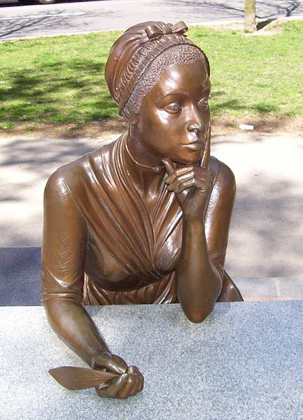
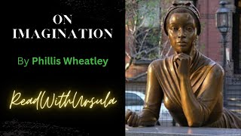
Reflections of a Writing Teacher… Who Is Still Looking for the Words
I’m a writing teacher with so much to learn from you, Phillis.
Like when…
You turn to writing because it’s all you have.
Like when…
You turn to writing to demand full humanity to all.
Like when…
You turn to writing to be visible in a world that invisibilizes you.
Like when…
You turn to writing to craft a voice that has been disregarded.
Like when…
You turn to writing to create a personhood in a world that has only made you its raw commodity.
Phillis teaches me…
That there is a different place from which to write… and therefore a different place from which to teach writing.
page created by
Carmen Kynard
5

Slide 6
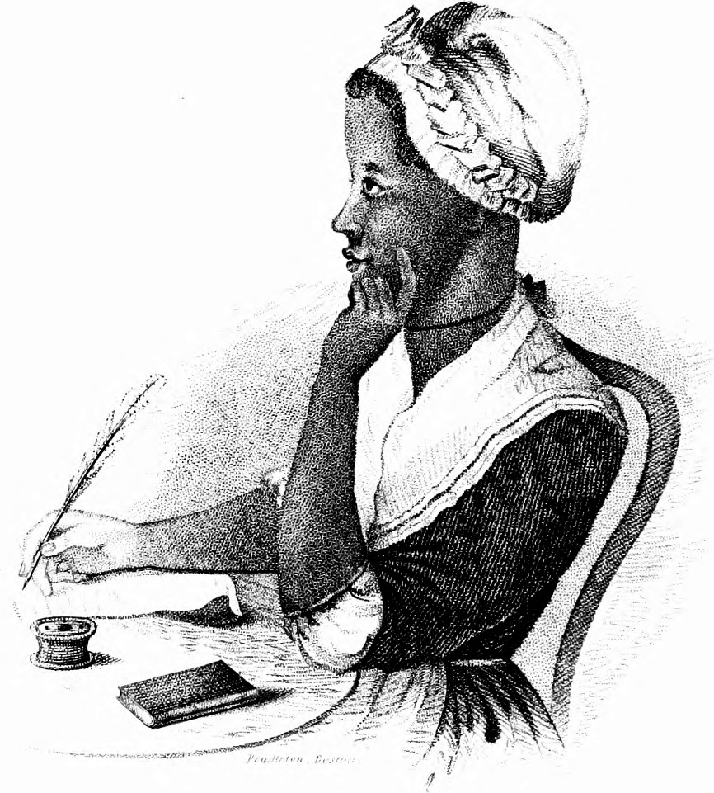
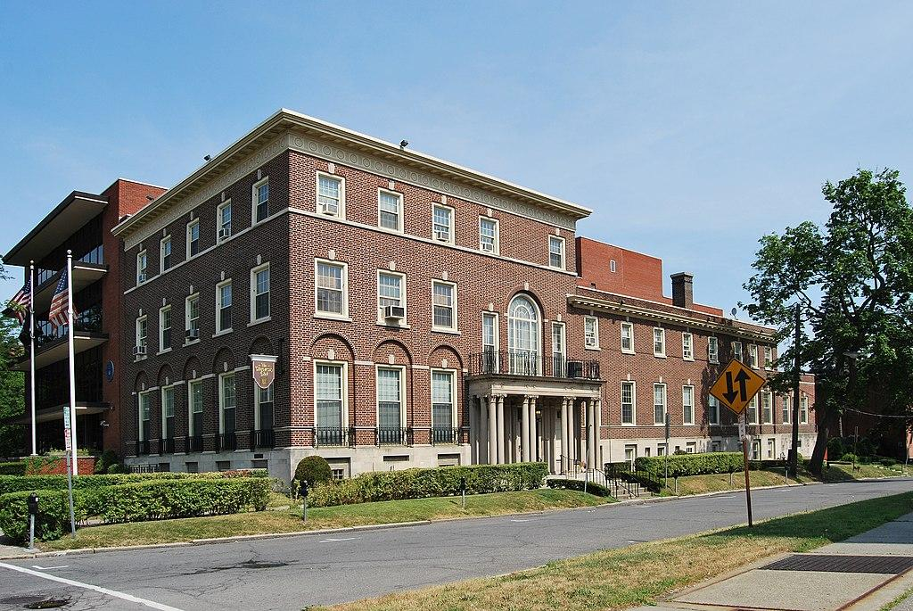
A Black woman,
An inspiration,
To those during, and those after.
A writer,
A role model,
To those in power and those oppressed.
A name stolen,
A freedom stolen.
A name given,
A freedom rewritten.
A society changed,
For those now and later.
Phillis
page created by Malee Miller
6

Slide 7
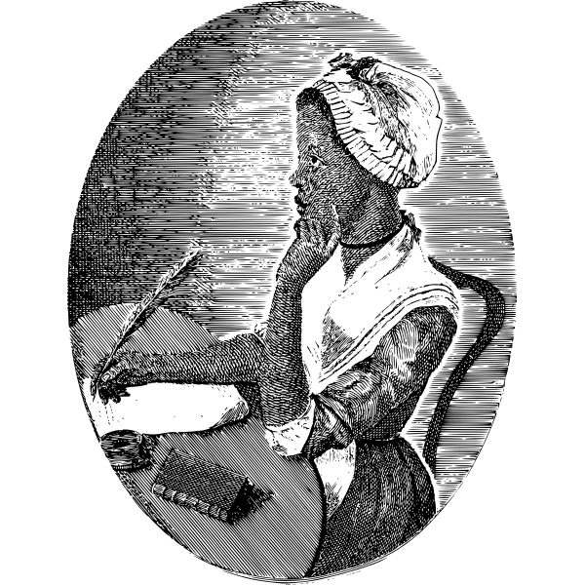
Inspired
Phillis
You inspire us.
How did you find words, so far from your home?
I see your writing
And I want to write too.
Statues honor you, but they stand still.
You kept moving and doing.
Walking in Boston, in places you went.
I couldn’t see you, of course.
But sometimes
I heard your voice in those spaces.
Imagined your presence
Returned.
May 2023 Boston Globe story
(click here)
on PWP
7
Page created by Sarah Robbins

Slide 8
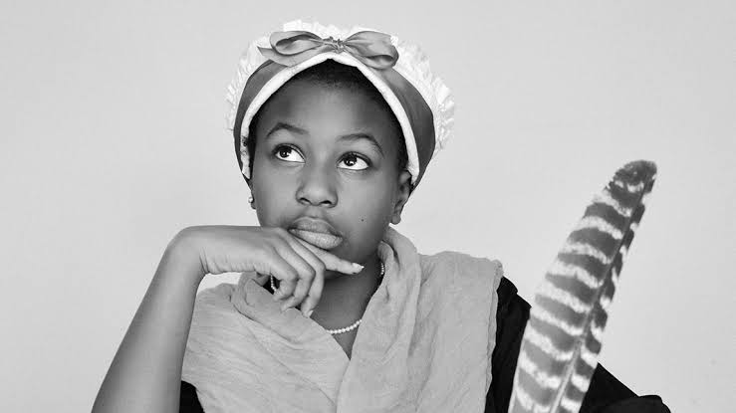
SHE
is a ROLE MODEL
is an AUTHOR
was DETERMINED
PERSEVERED
…used her poetry to fight against the inequality encouraged by slavery.
…became the first American slave, the first person of African descent, and only the third colonial American woman to have her work published.
…helped show that African Americans were equally capable, creative, intelligent human beings who benefited from an education.
8
page created by Sarahi Beasley - FWISD

Slide 9
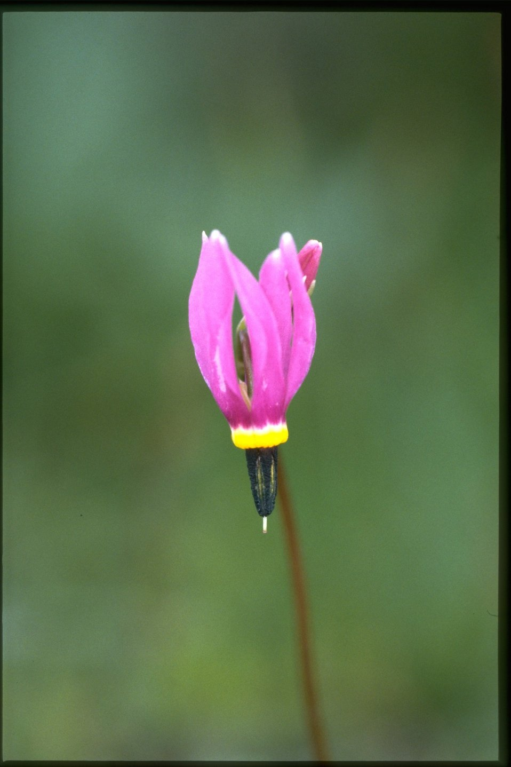
Genius
Phillis Wheatley Peters
Was ahead of her time
Writing down the line
To advance her mind
Keeping the time
For future mankind
Genius
page created by K. Lemmons
9

Slide 10
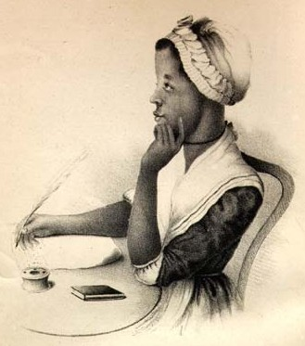
CELEBRATE
Phillis Wheatley Peters
She overcame
It didn’t matter where she started
She overcame
Racism, slavery, ownership
She discovered
She discovered her talents
Talents for learning, writing, creating poetry
She created
She created poetry
She created hope
Hope
She created hope for future girls
She created hope for future African Americans
She left her legacy for future generations
Celebrate Phillis Wheatley Peters!
page created by Nora Garcia
10

Slide 11
OUR GOAL:
To promote student writing in response to PWP’s life and work
Click boxes below for more materials.
Click here for contest flyers.
Send contest entry to:
https://tinyurl.com/DFW-contest
Email questions to:
DFWwritesPWP@gmail.com

